Slide 1
Getting to the Core of Common Core
Shauhna Feitlin
Academic Coach, Mathematics
La Habra City School District

Slide 2
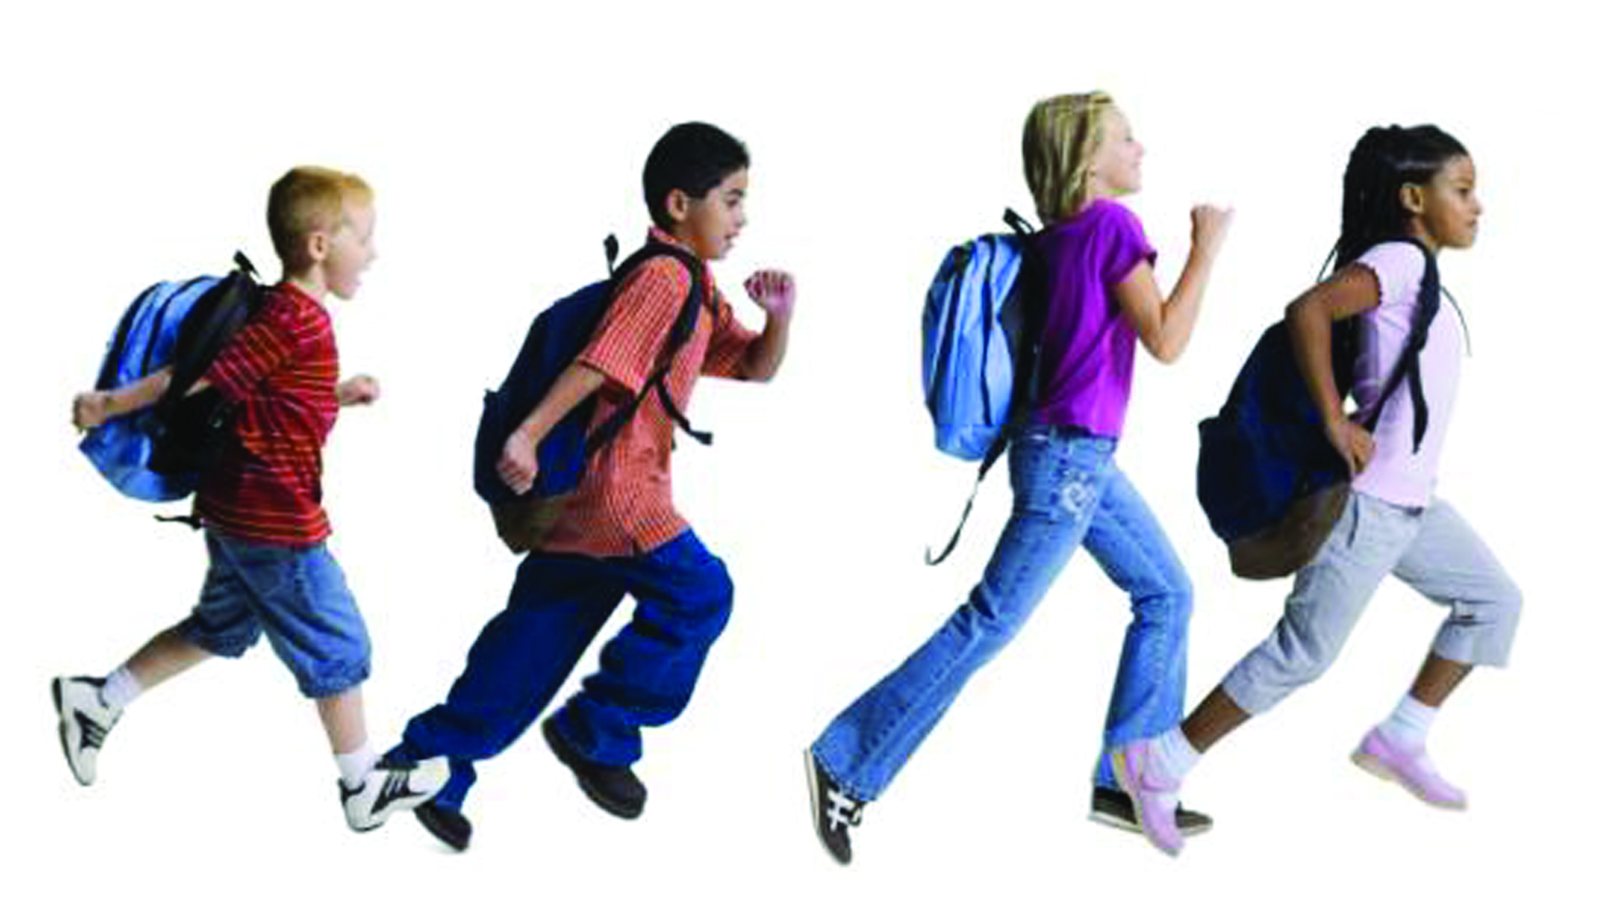

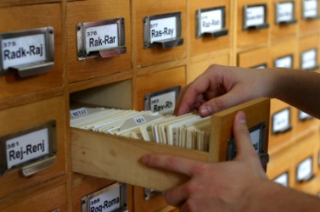
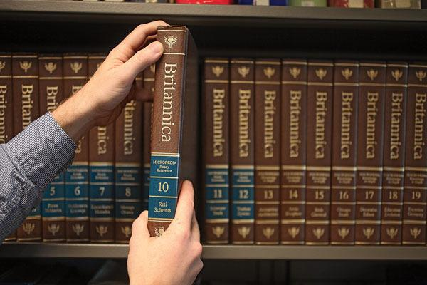
20th Century Skills VS 21st Century Skills
Notes:
Get to the Library - search topic - encyclopedia -

Slide 3


20th Century VS 21st Century Skills
Obtain & Retain
20th Century Skills
Think & Communicate
21st Century Skills
Notes:
Obtain & Retain Think vs Think and communicate

Slide 4
Shifts in Common Core Mathematics
Focus: Greater focus on fewer topics
Coherence: Within and across grade levels
Rigor: Deep, authentic command of concepts

Slide 5
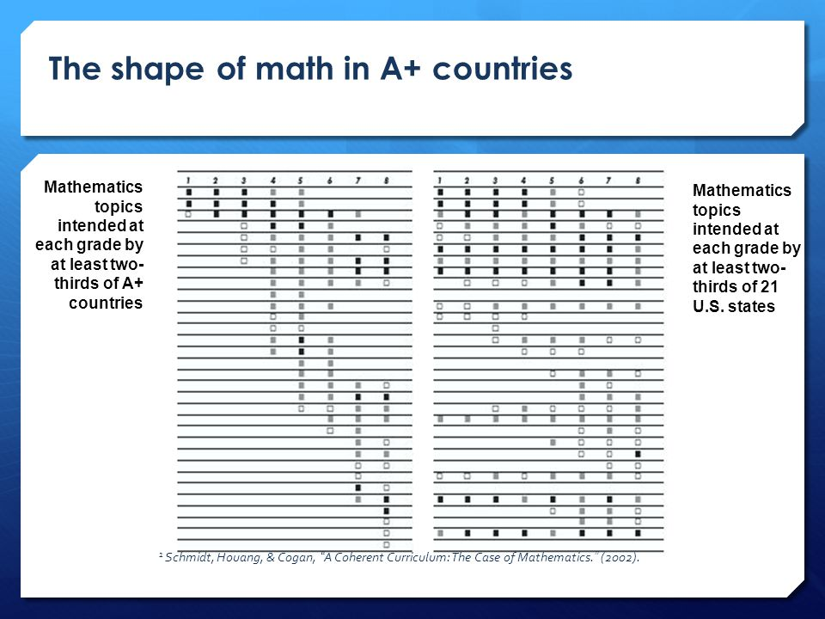
A+ Countries
Old Standards

Slide 6
Shift 1 - Focus
Greater FOCUS on fewer topics
In grades K–2: Number sense and addition and subtraction
In grades 3–5: Multiplication and division of whole numbers and fractions
In grade 6: Ratios and proportional relationships, and early algebraic expressions and equations
In grade 7: Ratios and proportional relationships, and arithmetic of rational numbers
In grade 8: Linear algebra and linear functions
Notes:
Rather than racing to cover topics that are a mile wide and an inch deep - Core narrow and deepen the way time and energy is spent teaching math
Focus deeply on the major work at each grade span

Slide 7

Shift 1- Focus

Slide 8

Group Discussion
Shift 1: Focus strongly where the standards focus.
“Why focus? There’s so much math that students could be learning, why limit them?”

Slide 9
Shift 2 - Coherence
Linking topics across grades and within
Coherent progressions from grade to grade
3rd Grade:
Whole Number X Whole Number
4th Grade:
Whole Number X Fraction
5th Grade:
Fraction X Fraction
Notes:
Each standard is not a new event but an extension of a previous one.

Slide 10
Shift -2 Coherence
3.MD.7a Find the area of a rectangle with whole-number side lengths by tiling it, and show that the area is the same as would be found by multiplying the side lengths.
3.OA.3 Use multiplication and division within 100 to solve word problems in situations involving equal groups, arrays, and measurement quantities, e.g., by using drawings and equations with a symbol for the unknown number to represent the problem.
 |  | 3
2

Slide 11
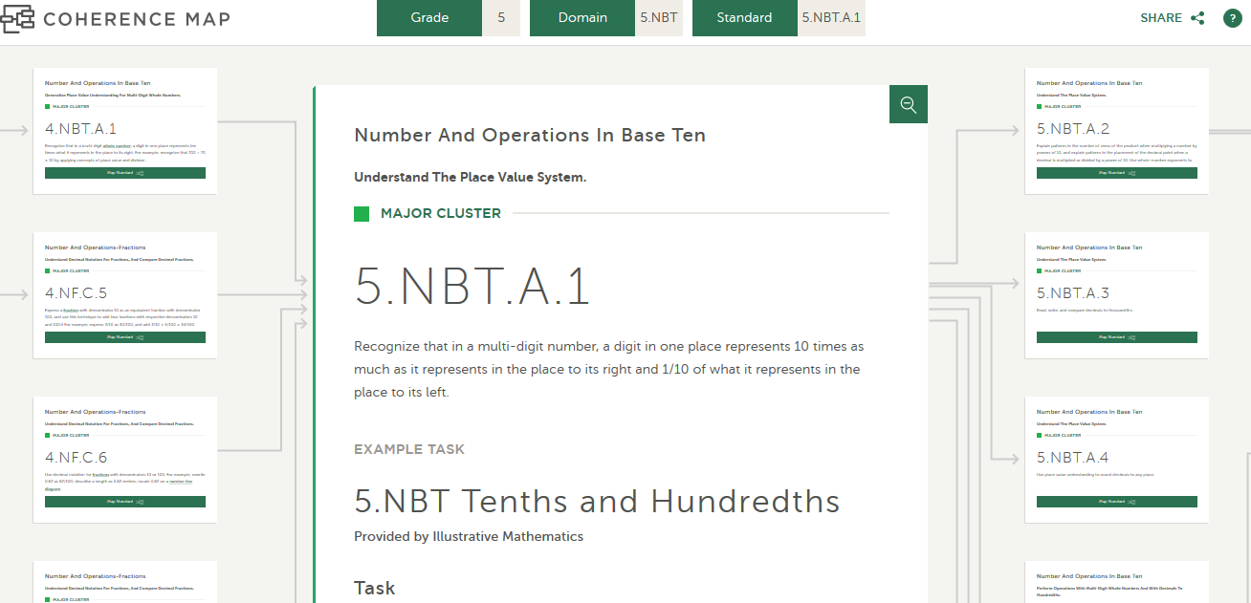
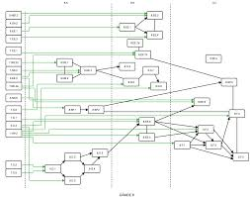
Coherence - Achieve the Core
Jason Zimba

Slide 12
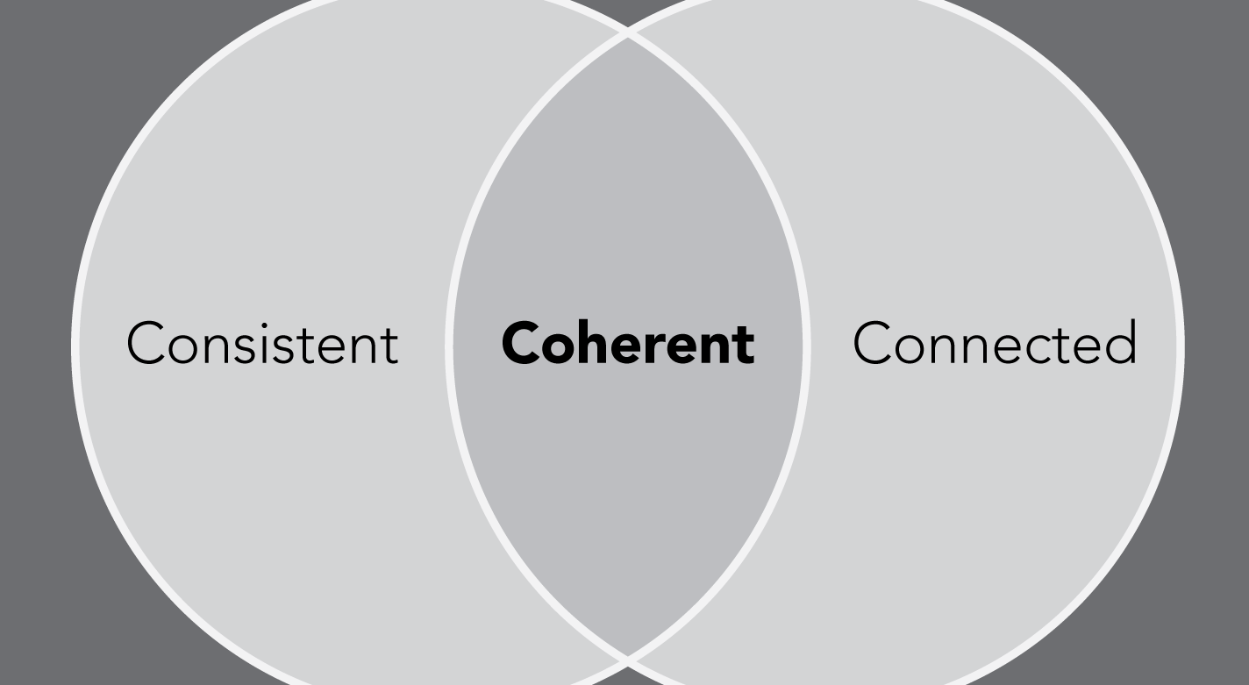
Group Discussion
Shift 2: Think across grades, link to major topics within grades.
What does coherence in the math curriculum mean to you?
How will you use coherence in units of study?

Slide 13
Shift 3 - Rigor
The CCSSM require balance of:
Solid conceptual understanding
Procedural skill and fluency
Application of skills in real world situations
Equal intensity in time, activities, and resources

Slide 14
Fast Memorizers
Shift 3 - Rigor
VS
Thinking Slowly, Deeply, Creatively
(9x5) + (9x1)
9 x 6
(9 x 2) + (9 x 2) + (9 x 2)
3 x 9 x 2

Slide 15
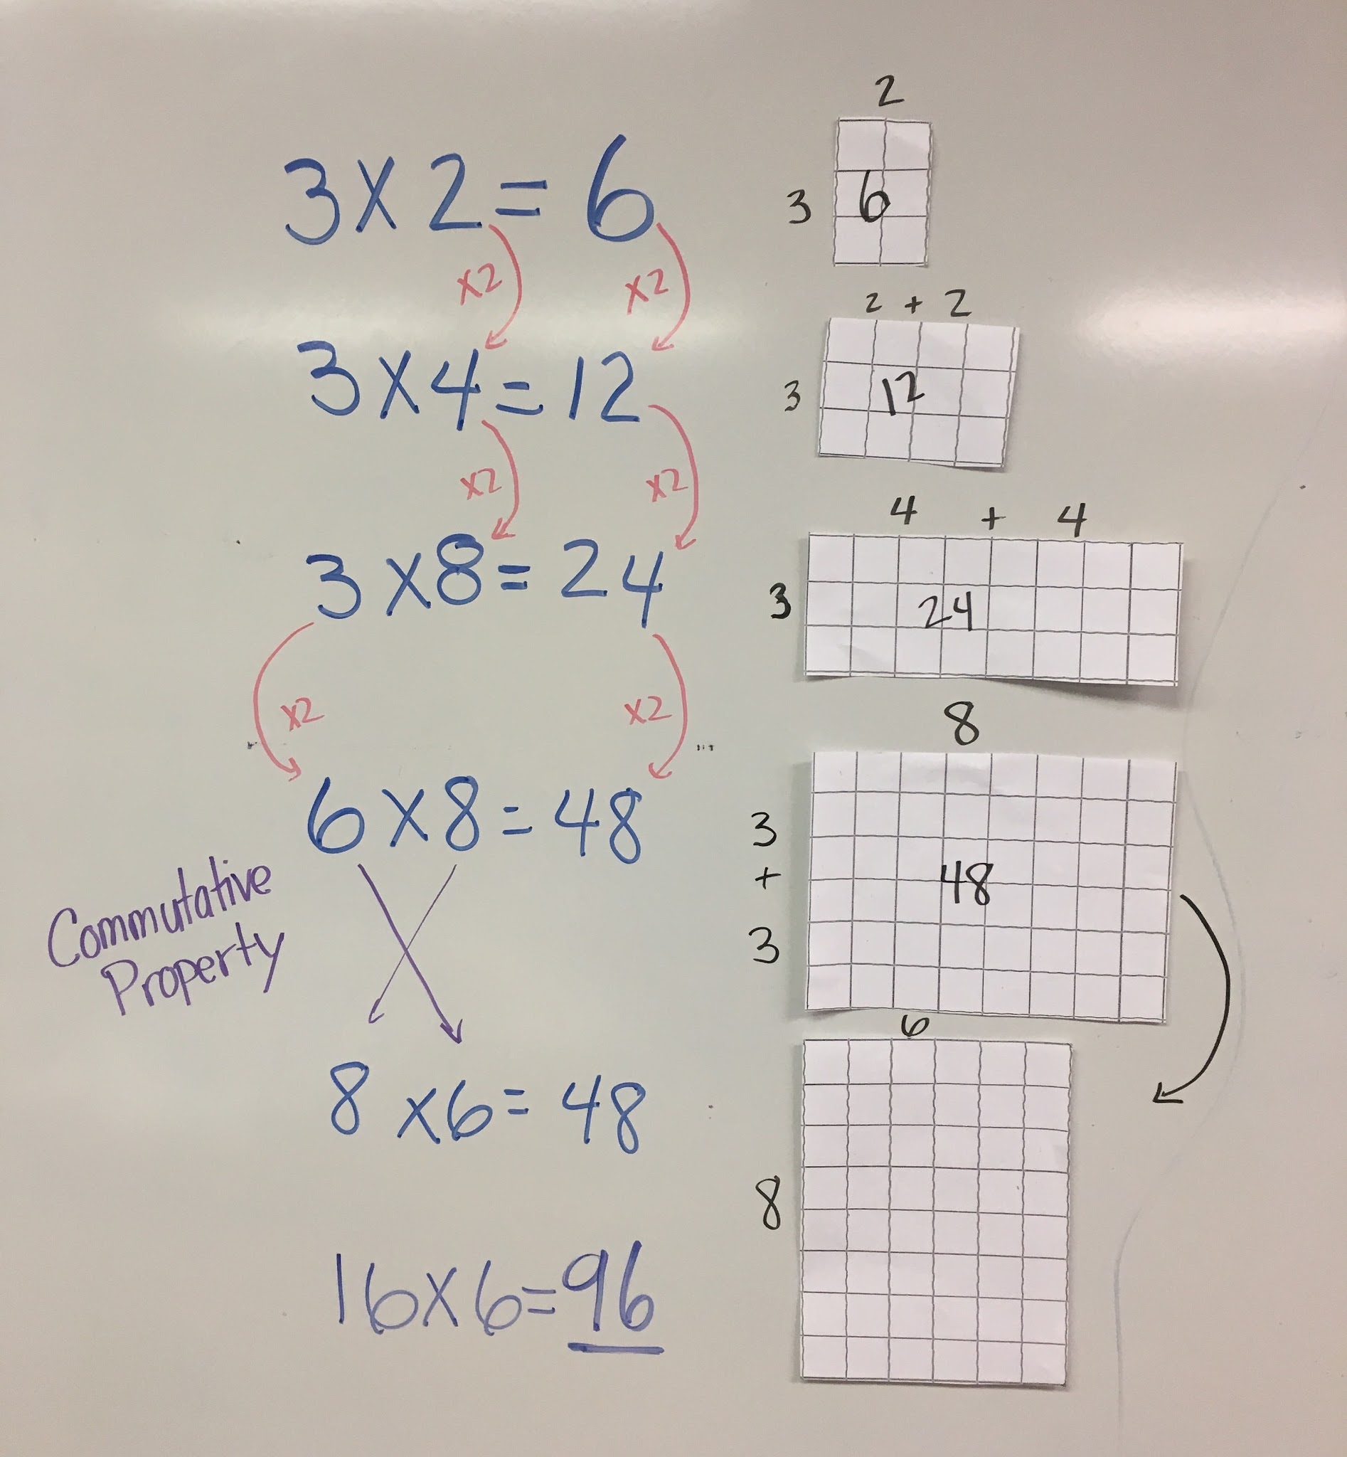
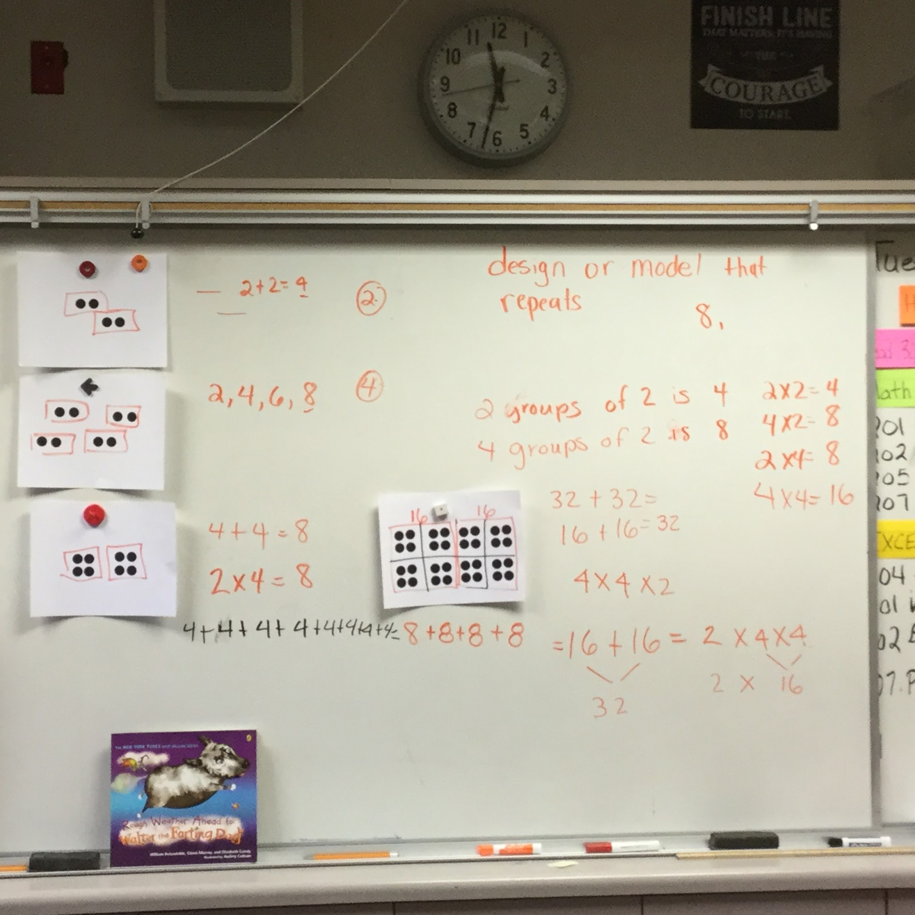
Developing Fluency/Conceptual Understanding

Slide 16


Application in Action
Jared collects baseball cards. He keeps his cards in an album. The album has 9 pages. If each page holds 6 cards, how many baseball cards does Jared have?

Slide 17
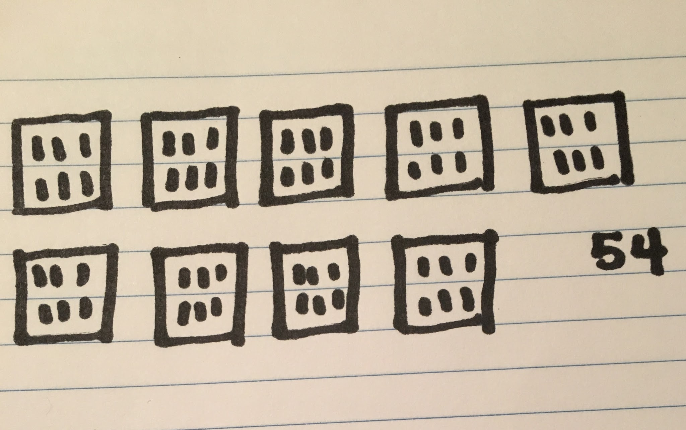
Direct Modeling

Slide 18
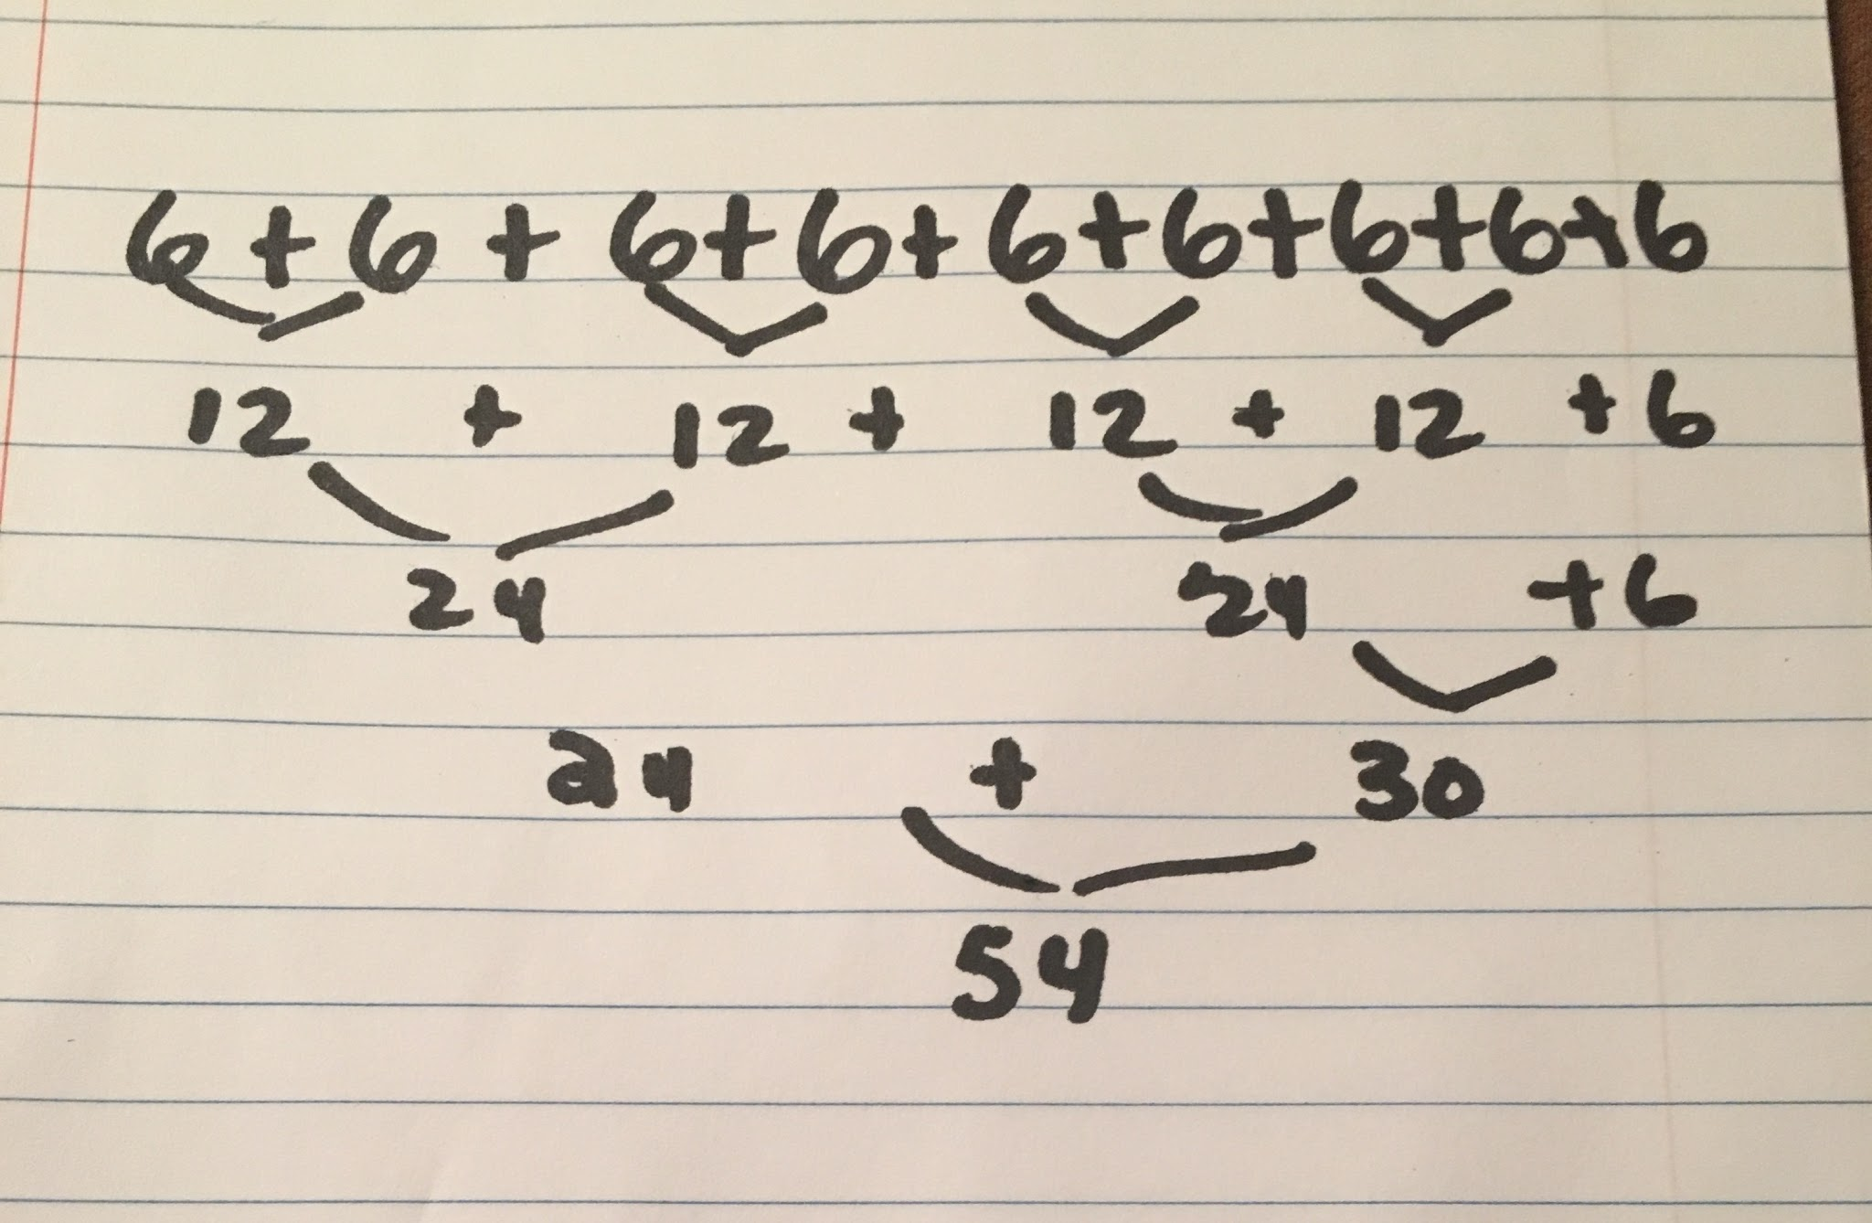
Counting

Slide 19
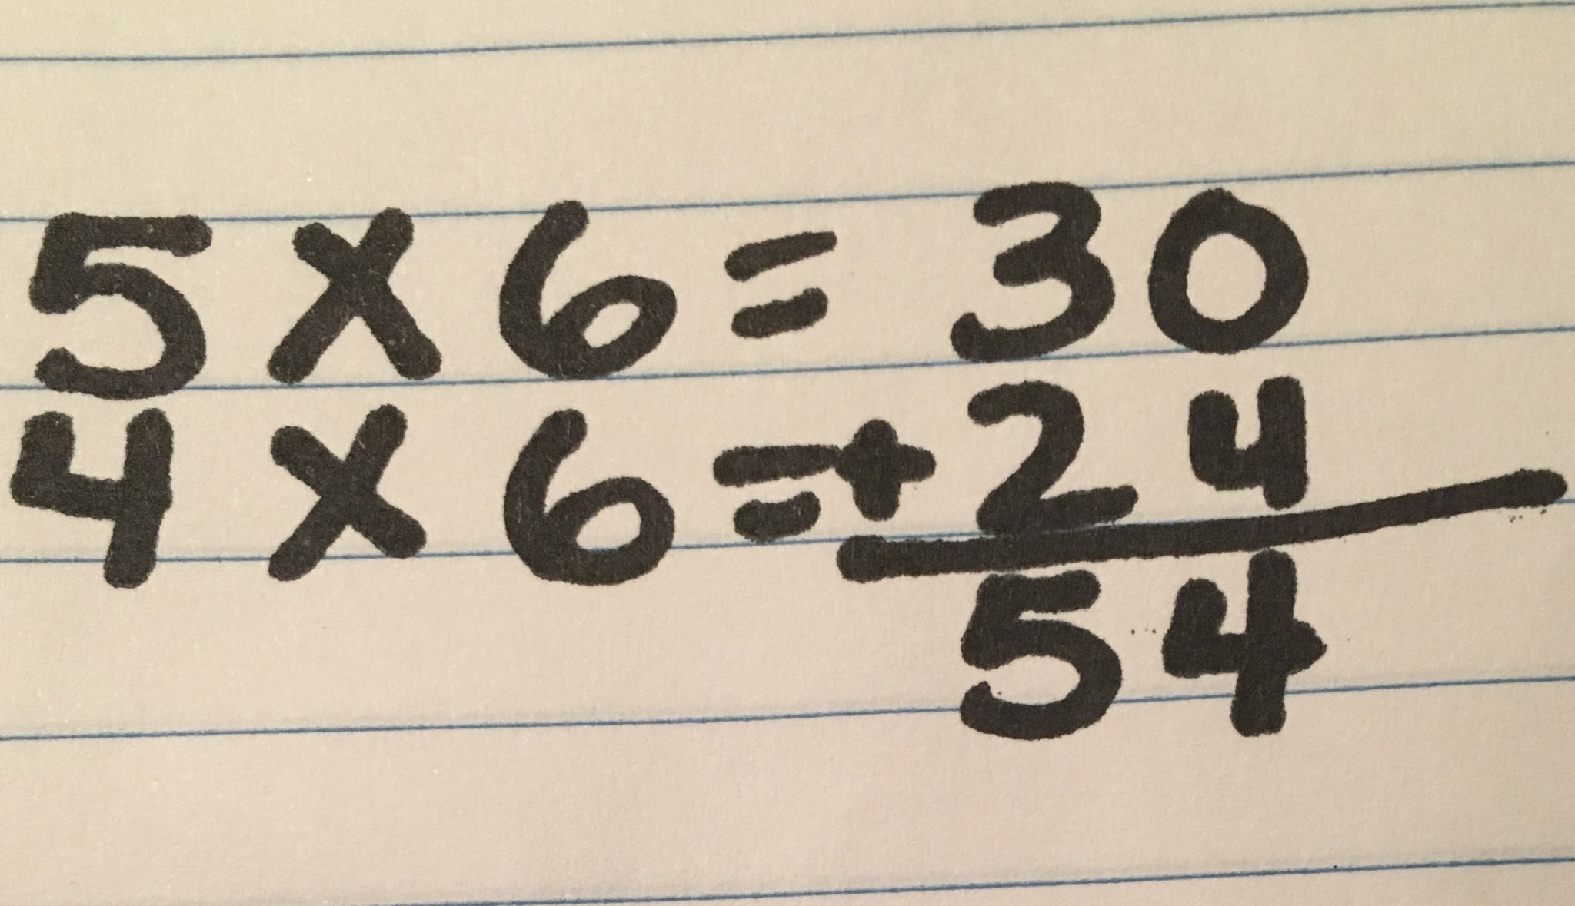
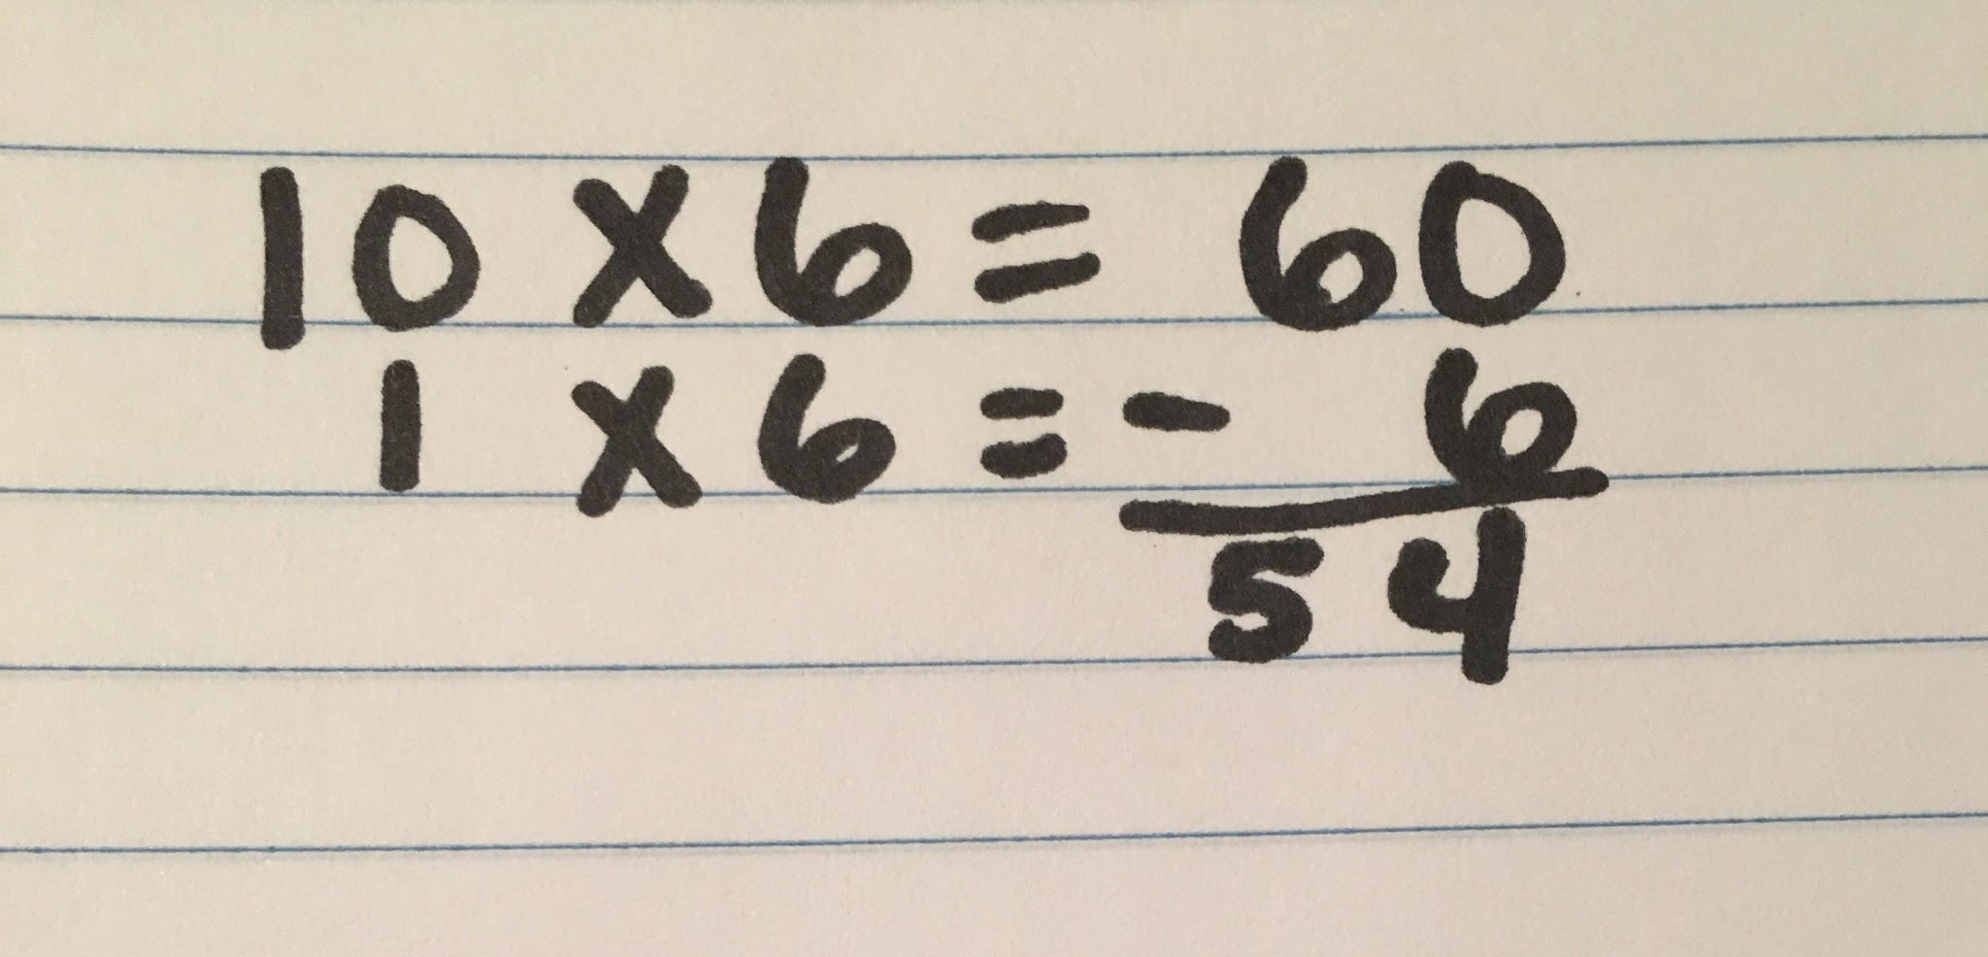
Relational Thinking
9 x 6 = (5 x 6) + (4 x 6)
9 x 6 = (10 x 6) - (1 x 6)

Slide 20
Make Connections to Conceptual Understanding

Slide 21

Group Discussion
Shift 3 Rigor: Deep, authentic command of concepts
Why not just teach the standard algorithm? That’s how I learned.

Slide 22
Old School
1 What is 6050.287 rounded to
the nearest ten?
6050
6100
6050.29
6050.3

Slide 23
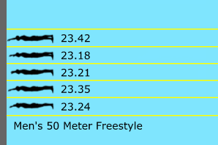
New School
Five swimmers compete in a 50 meter race. The finish for each swimmer is shown in the video.
Explain how the results of the race would change if the race used a clock that rounded to the nearest tenth.

Slide 24
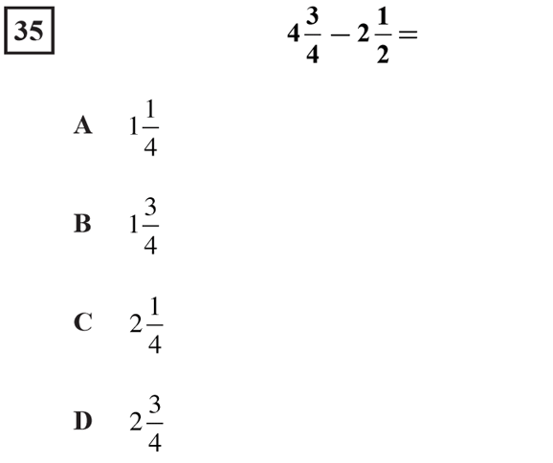
Old School

Slide 25
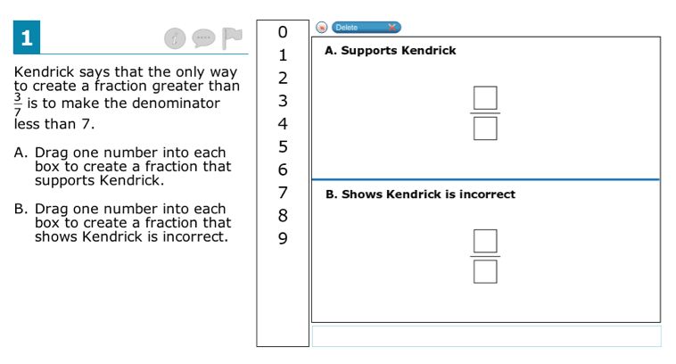
New School

Slide 26
Achieve the Core
“In a nutshell the CCSS expect that instead of knowing the answers, students must be able create the answer, make claims and produce evidence to support their claims.”

Slide 27
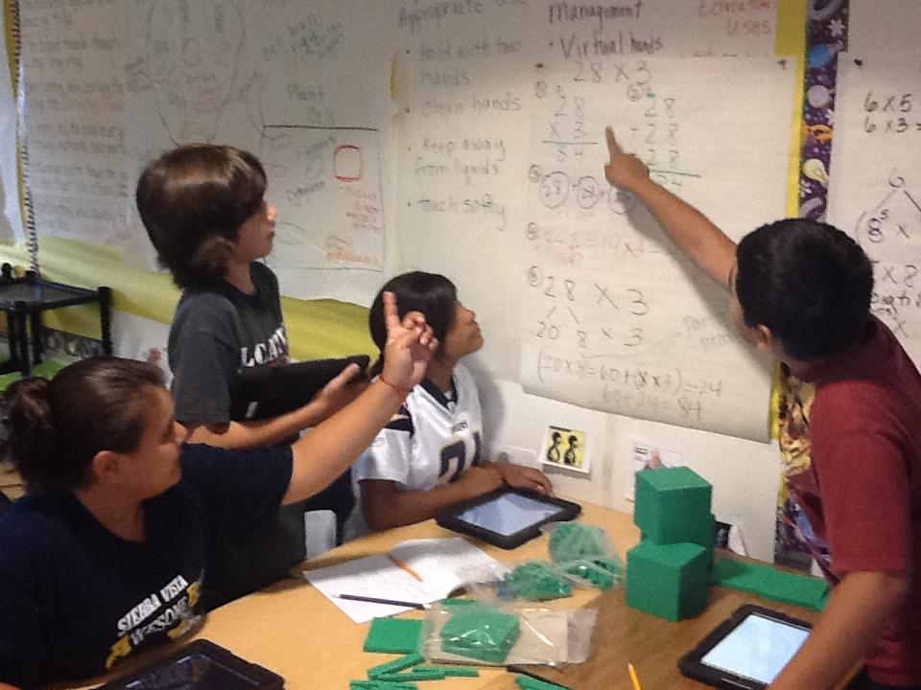
Take Away
The purpose of the Common Core is to teach students to…
Think and Communicate

Slide 28
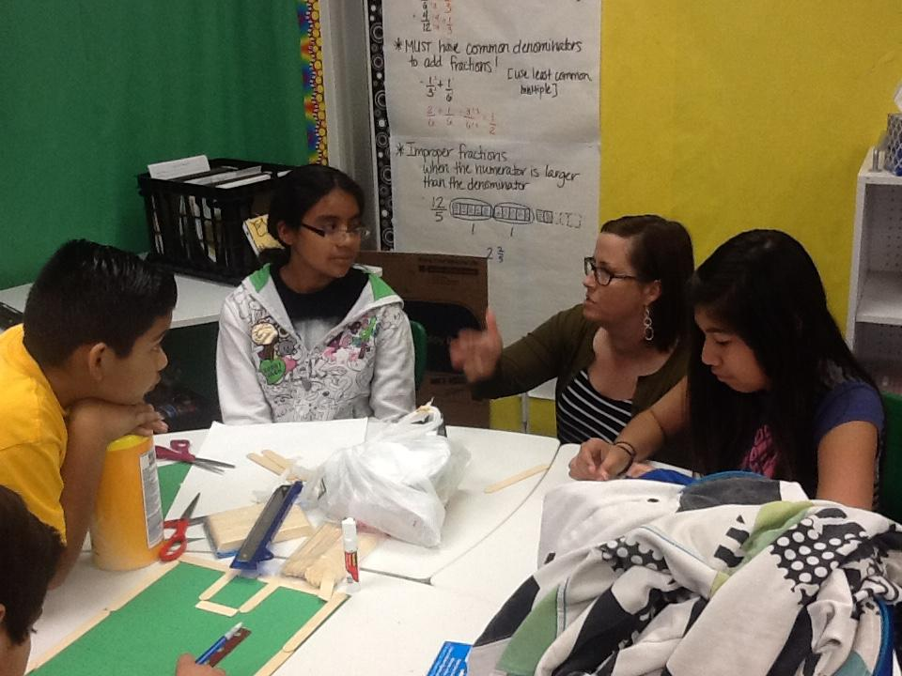
Questions?

